Slide 1


Smart sorting
How to build the bridge
between a package and its last mile driver
Sharing Session

Slide 2
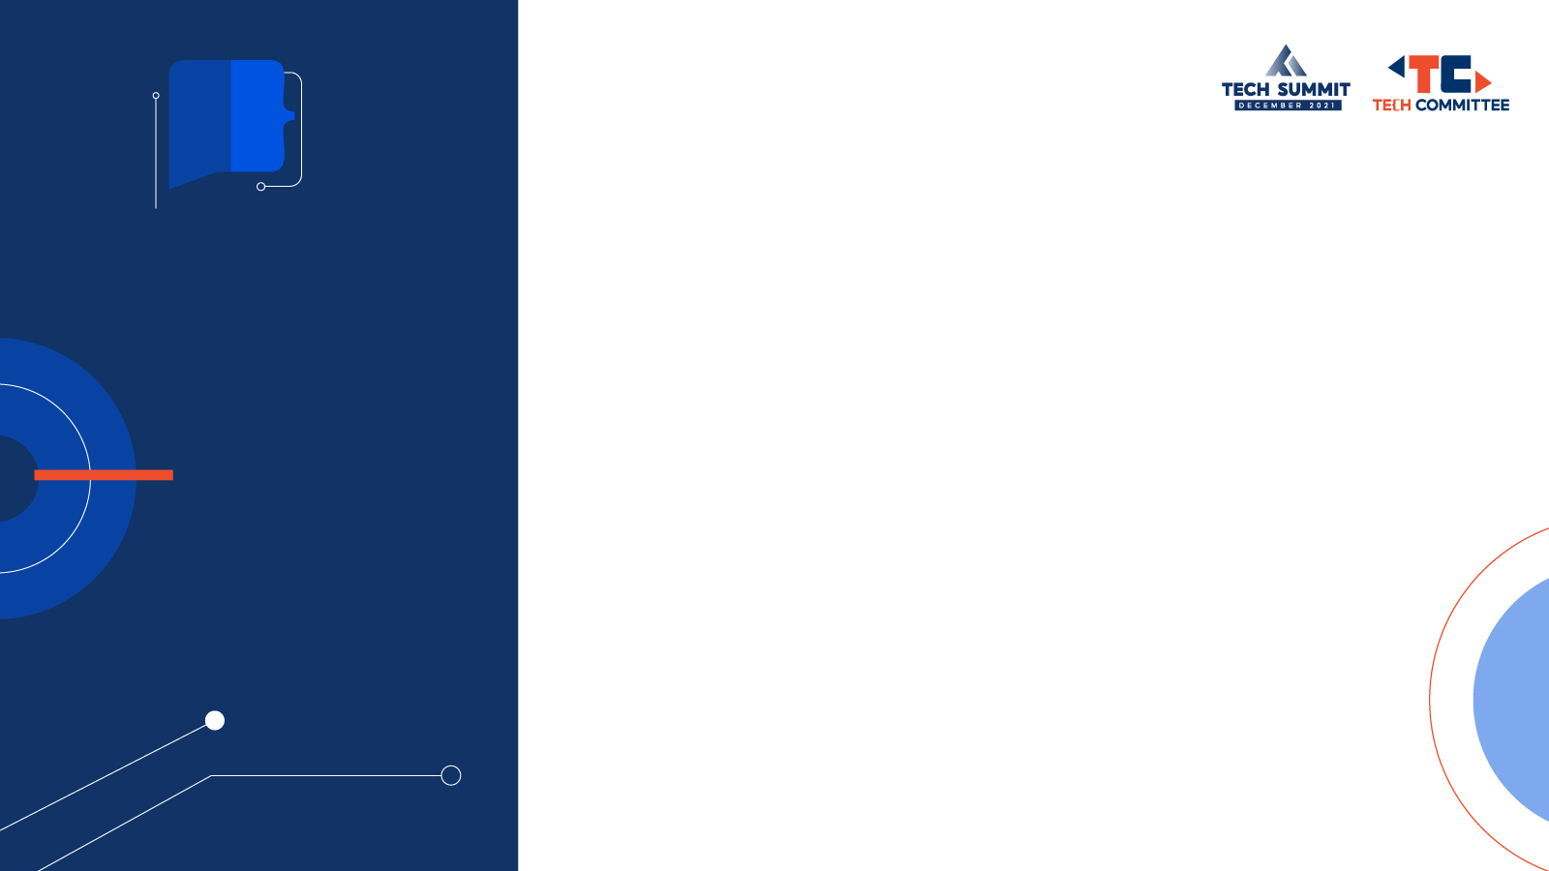

Self
Introduction
Shiping Gong, Shopee Supply Chain Algo
Joined Shopee in 2021.04
Data related fields, Especially its application in supply chain

Slide 3
Problem / Pain Point
manual sorting is time-consuming
manual sorting makes a lot of mistakes
Our Solution
POI method(longitude and latitude)
AOI method(standard structured address)
Our Users
SPX and all the SLS partners
Our Team Members
SPX & SCI & MAP
Context

Slide 4
Background of smart sorting
Sort by POI method
Sort by AOI method
Theory discussion
Looking forward into the future
Agenda

Slide 5

Background of smart sorting

Slide 6

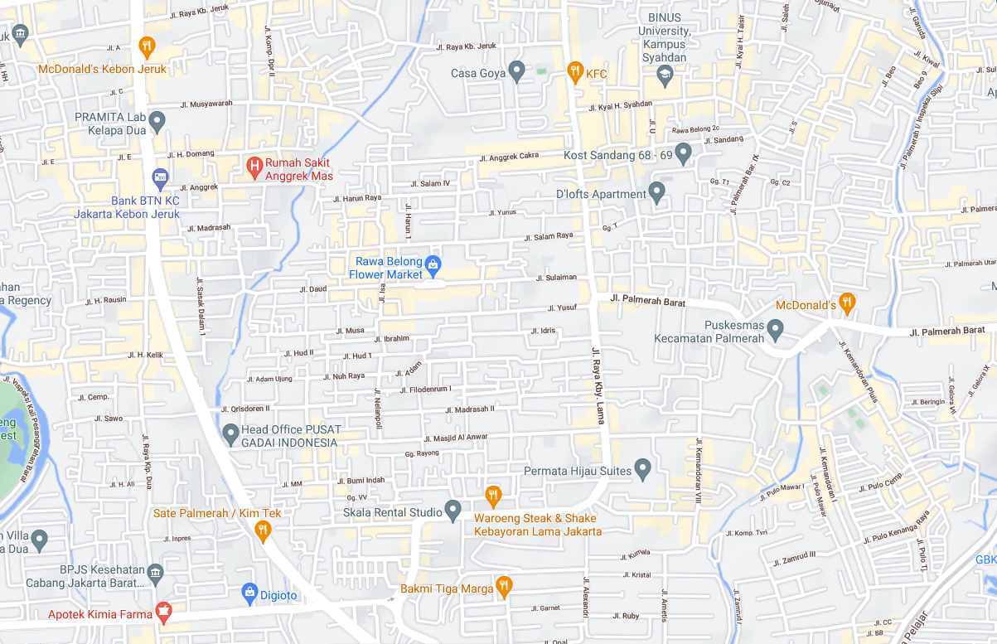

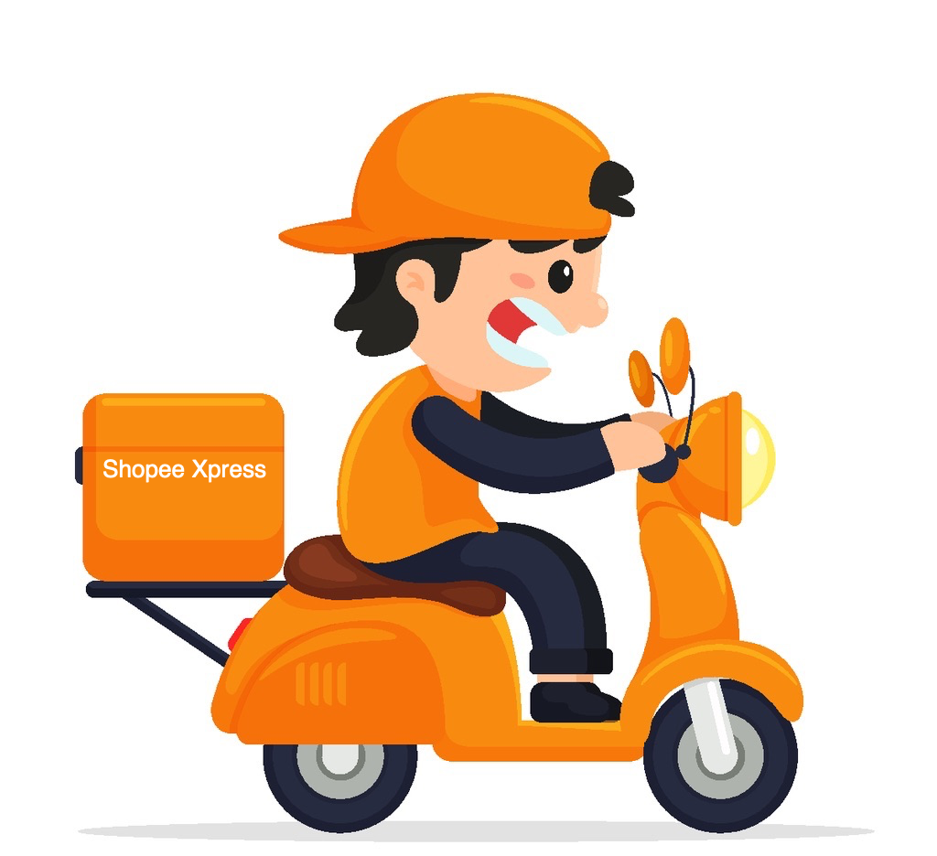

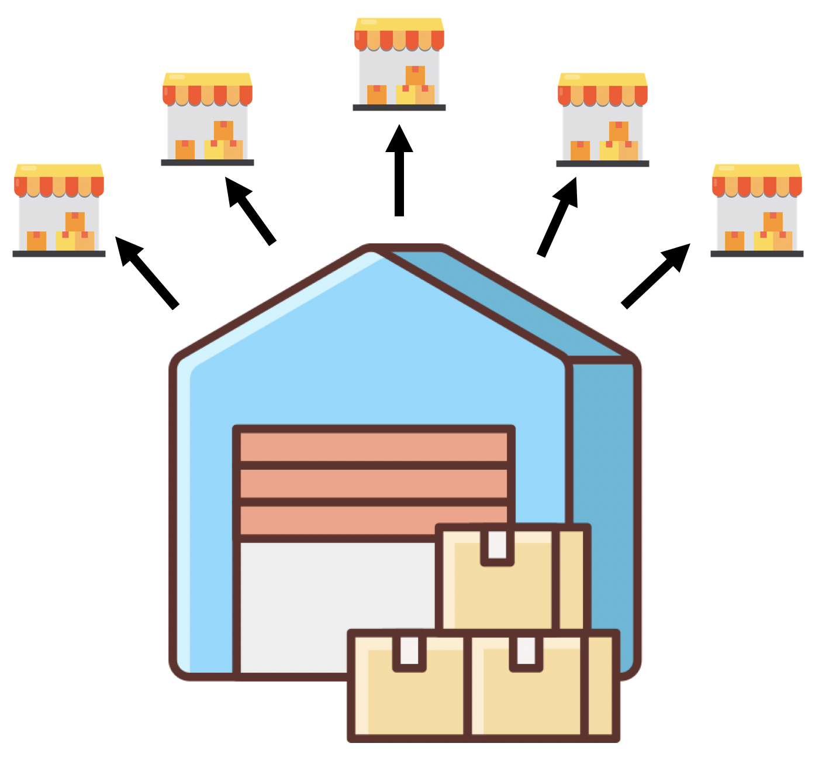

The journey of a package
Marketplace
Seller
First Mile Hub
Pickup
Pickup
First Mile Hub
SOC-FM
SOC-LM
Last Mile Hub
Delivery
Delivery
Buyer

Slide 7
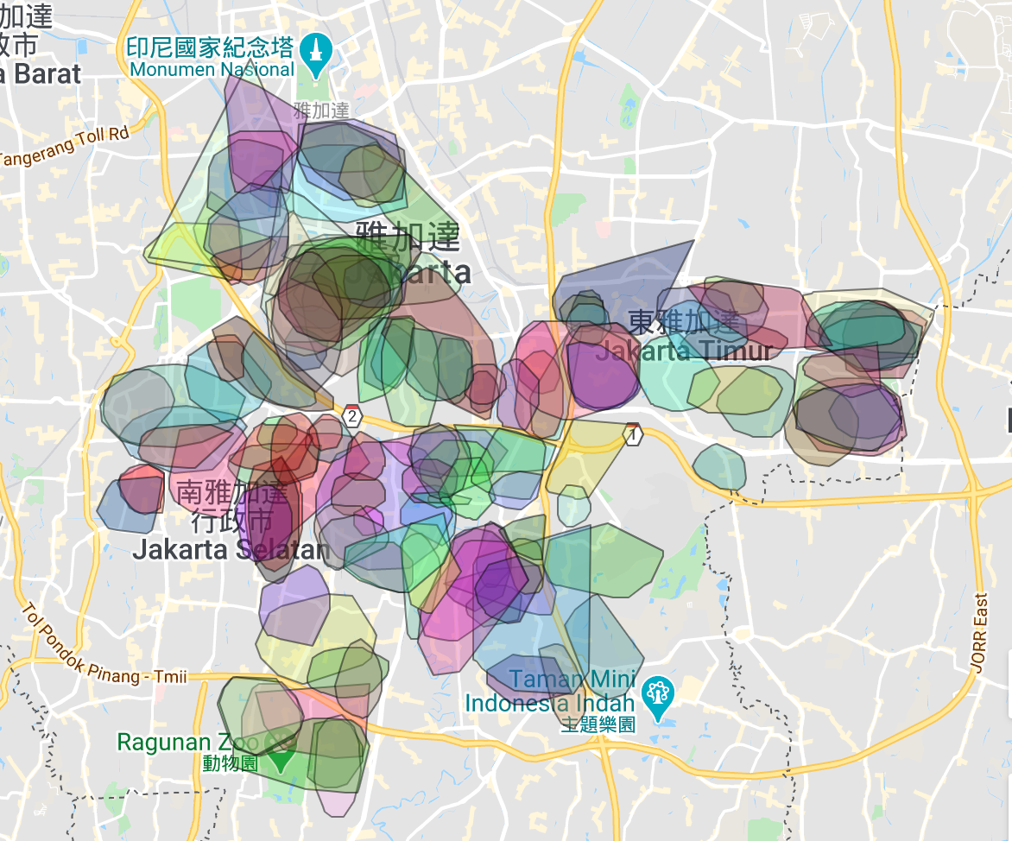
What was before
different drivers were responsible for the same area
some drivers were responsible for a much larger area than others
Notes:
what you can see from this picture? At the first blush, you may find confusion, but you also can find that drivers are trying to segment the areas separately, though not so successful.

Slide 8


What we could improve
Efficiency
8s * 5,000,000（packages） = 40,000,000 senconds
40,000,000 / (60 * 60 * 8) = 1,389 (human labor)
Consumer experience
5% * 5,000,000 = 250,000 (mistakenly sorting)
delivery time increase one day per package
Notes:
http://www.spb.gov.cn/ztgz/gjyzjzt/2017kdwj/2017mtbd/201711/t20171114_1427343.html
suppose the packages will double in next year
suppose we could help not only SPX but all the logistic partners

Slide 9
Extra Benefit
driver capacity
delivery time
10%
Notes:
driver capacity increase about 10%
avg delivery time decrease about 10%

Slide 10
2. Sort by POI method
--a simple and natural solution

Slide 11
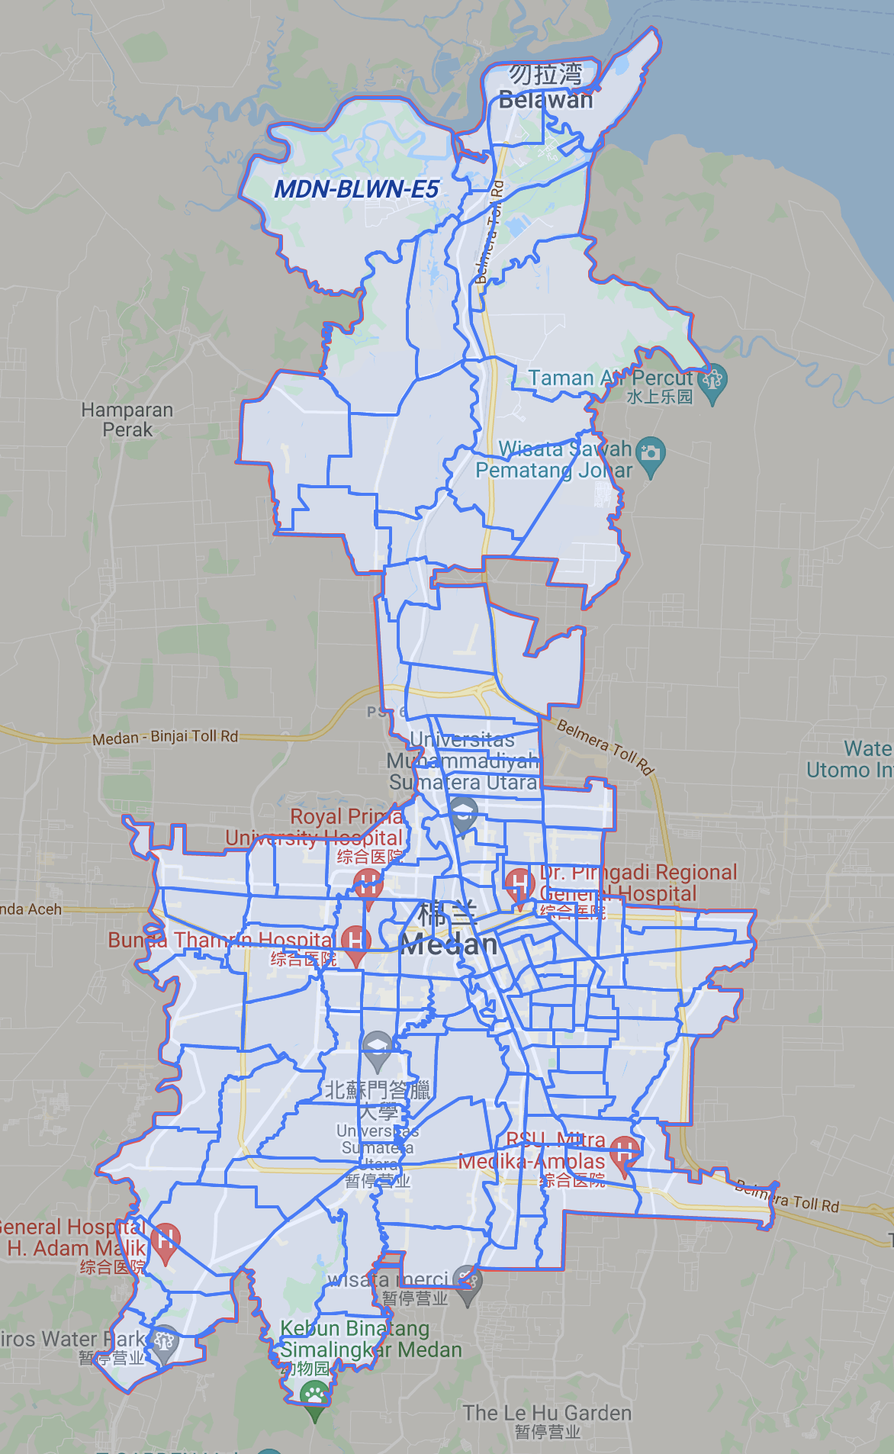
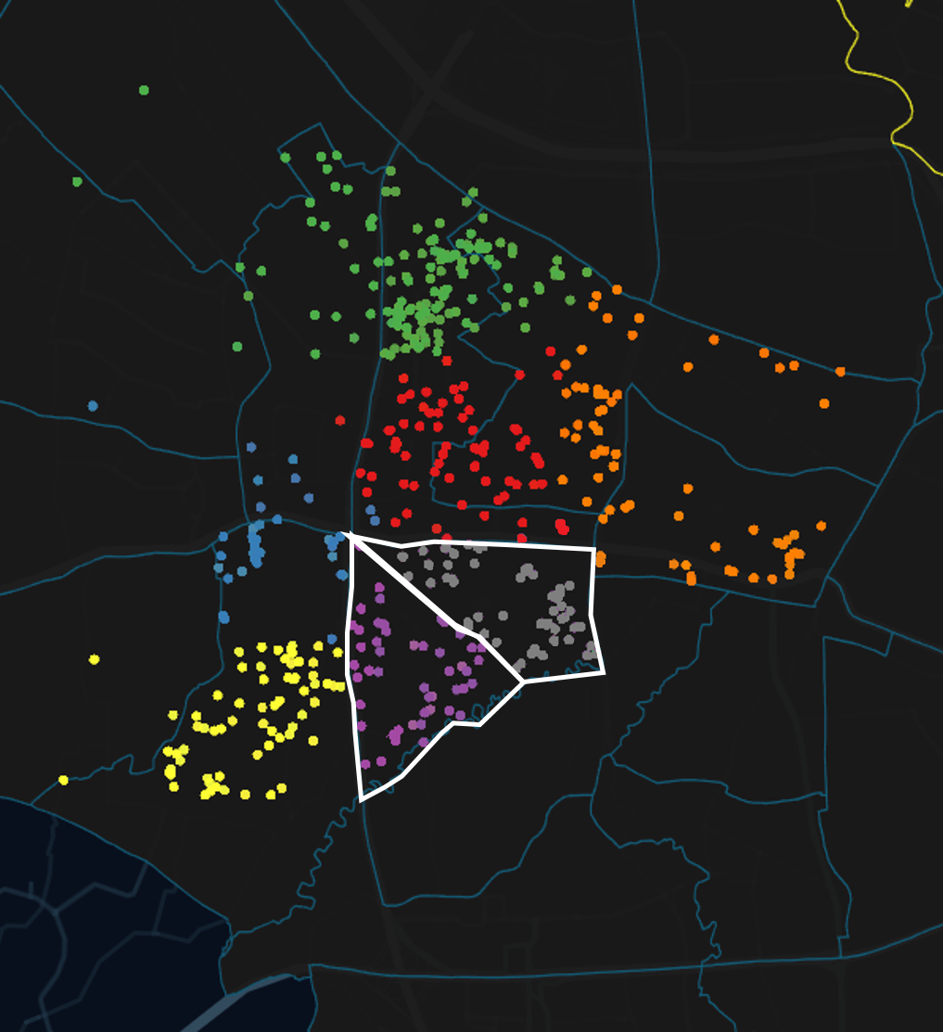
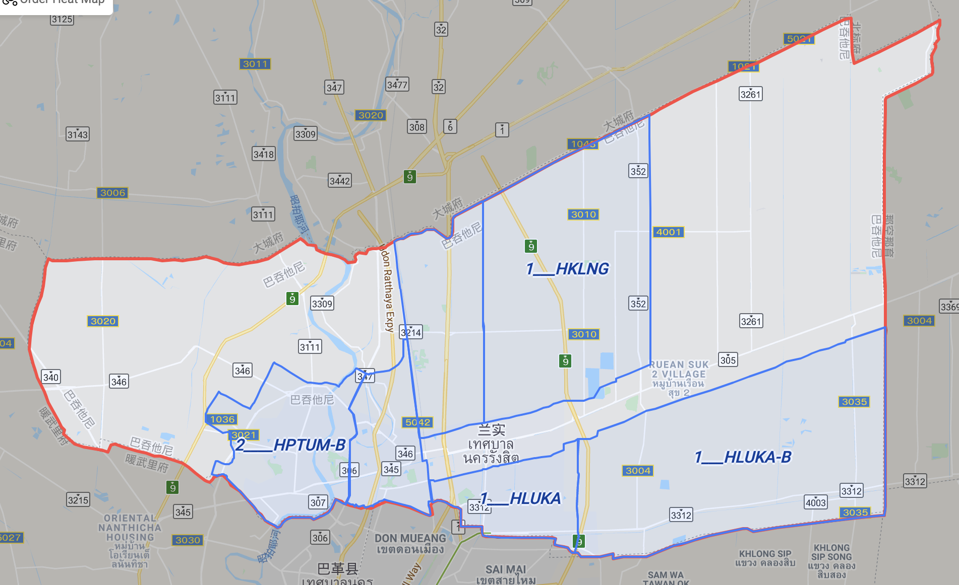
Define a hub / a zone
Define the area of each hub
Segment each driver's delivery zone
Notes:
1. At first we have to define a area, then we can do the distribute thing, hub is big and zone is small, we will use zone in the follow-up slides
2. Each hub or zone is defined by the boundary which formed by longitude and latitude
3. Operators have to draw the hub/zone on the map
4. Map team has to offer some map information

Slide 12
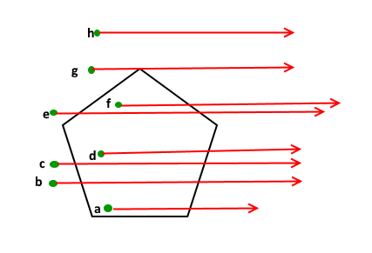
How do we know which zone an address belongs to?
Address -> (x, y) -> Zone -> Driver
How to check if a given point lies inside or outside a polygon?
Notes:
1. This is a classical problem and there are classical solutions, just google it
2. If a zone is defined by longitude and latitude then we could only use the address’s coordinate to sort, this means a lot, we will discuss this in the subsequent slides

Slide 13
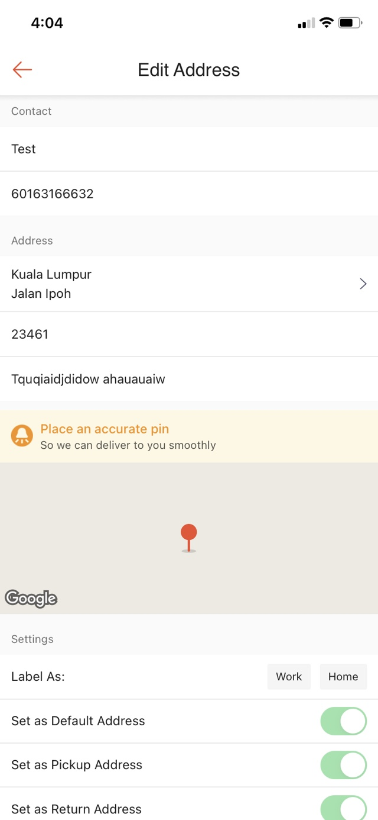
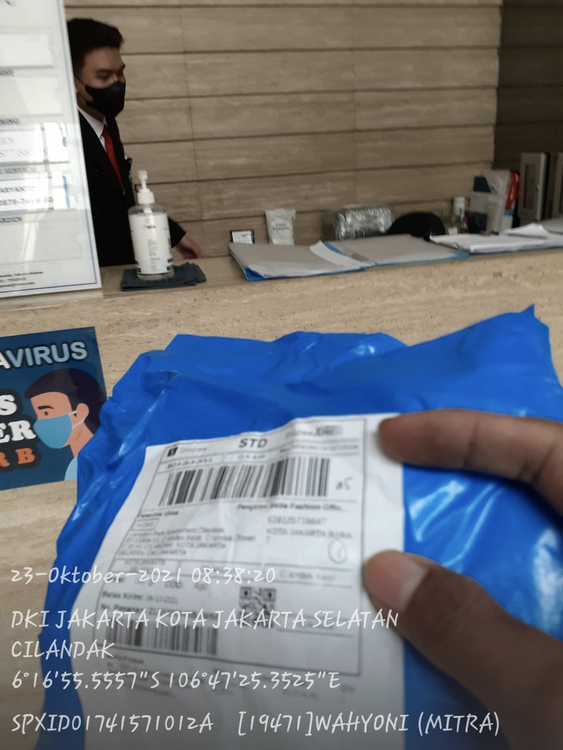
How do we get the accurate coordinate of each address?
user pin:
driver pin
google map
manual pin

Slide 14
Centroid point method
POI's coordinate is caculated by Centroid Method
Each represents a driver_pin
Each represents the centroid point
Different colors indicate different POI
maybe unreliable because of the lack of driver_pin
reliable
Notes:
假设每个driver有60%的概率遵循sop在签收地点打卡，请问获得95%正确的(x, y)的概率，需要多少个driver pin？

Slide 15
A Probability problem
Hypothesis:
Suppose driver pins have a bi-nominal distribution of (0.7, 0.3), Which means the accurate probability of each driver pin is 0.7. And we also suppose that the errors have a normal distribution.
Problem:
How many pins do we need to make sure that the centroid point has at least a 95% accurate probability?
Notes:
假设每个driver有60%的概率遵循sop在签收地点打卡，请问获得95%正确的(x, y)的概率，需要多少个driver pin？

Slide 16
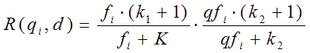
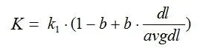
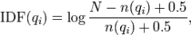
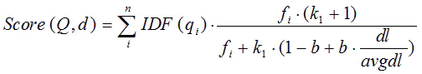
What if an address doesn’t have a coordinate?
BM25 algorithm
1.normally we set k1=2,b=0.75；
2.fi is the frequency of qi in d;
3.qfi is the frequency of qi in Query. normally, qfi=1
4.dl is the length of d, avgdl the average length of all sentences

Slide 17
Pros VS Cons
Pros | Cons
Zones are drawn based on map, easily understand by operators and drivers | Map must be accurate and powerful
Could easily be deployed and applied | Both user pin and driver pin are not so accurate and difficult to improve
As the data accumulates, the accuracy rate grows naturally | Longitude and latitude always drift(It doesn’t matter if the zone is big, but does matter when the zone is small )
 | Hard to know what is right and what is wrong
Notes:
It seems that longitude and latitude method can easily solve this problem well, but really?

Slide 18
3. Sort by AOI method
-- based on standard structured address

Slide 19
What is AOI?
POI—Point of Interest
Single address, place name, geo coordinates, place details, etc
AOI—Area of Interest
A geographically clustered area, which contains several POIs
AOI—1
AOI—2
A
D
B
E
C
AOI is defined by the administrative hierarchy, for example, a rt or a jalan.

Slide 20
An Example of AOI
POI | Address | RW | RT | AOI
A | Jalan Aselih No.9d, RT.10/RW.1, Cipedak, Jagakarsa (dekat perumahan deviva residence) | 1 | 10 | RT.10/RW.1,Cipedak
B | De Viva Residence, Jalan Aselih, RT.10/RW.1, Cipedak, Jagakarsa (NO.A9) | 1 | 10 | RT.10/RW.1,Cipedak
C | Jalan aselih no.92F RT 10 RW 01 cipedak jagakarsa jaksel (Warung soto kudus) | 1 | 10 | RT.10/RW.1,Cipedak
D | Vila Lontar Asri No. 3, Jl. Aselih RT.11/RW.1, Cipedak, Jagakarsa | 1 | 11 | RT.11/RW.1,Cipedak
E | Villa Lontar Asri, Jalan Aselih, Cipedak, Jagakarsa, RT.11/RW.1 No 8, Jakarta Selatan (no 8) | 1 | 11 | RT.11/RW.1,Cipedak
province | city | district | town | RW | RT | jalan | jalan No.
Jakarta | Kota Jakarta Selatan | Jagakarsa | Cipedak | 1 | 10 | Aselih | 9d
Notes:
RT is Rukun Tetangga or Neighborhood Unit
RW refers to Rukun Warga or Community Unit

Slide 21
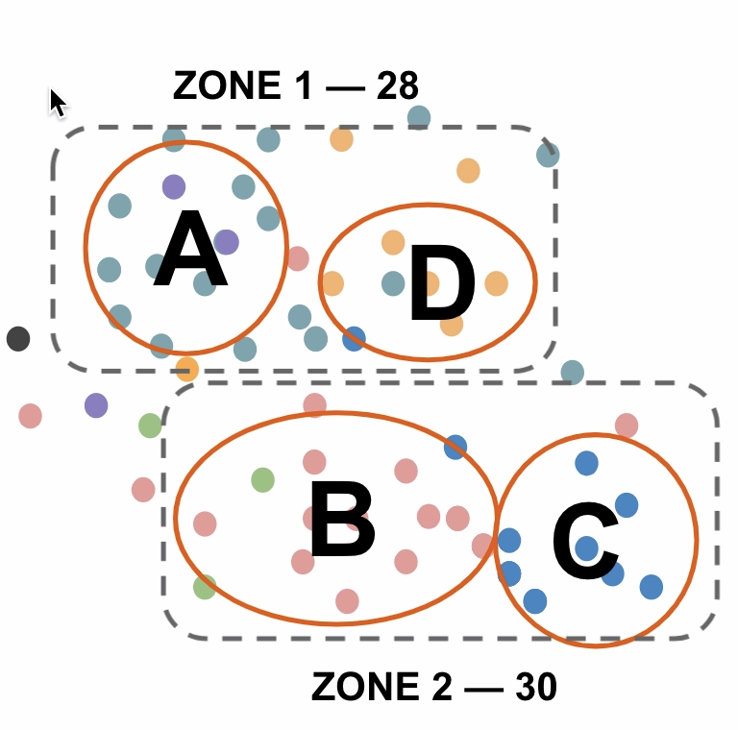
Why might AOI be more accurate?
POI
AOI
POI
AOI
RT | House no | driver_pin | Zone | aoi | zone
A | NO23 | 3 | 1 | A | 1
A | NO25 | 17 | 1 | A | 1
B | NO11 | 1 | 1 | B | 2
B | NO19 | 3 | 1 | B | 2
B | NO5 | 16 | 2 | B | 2
C | NO12 | 10 | 2 | C | 2
D | NO7 | 8 | 1 | D | 1
ZONE 1— 32
ZONE 2—26

Slide 22
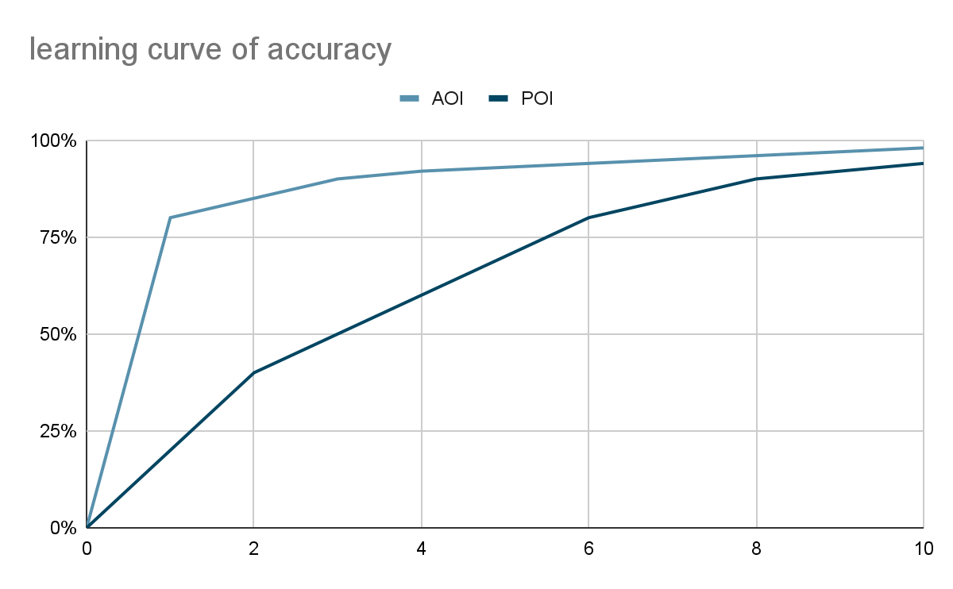
Learning curve

Slide 23
How to build standard structured address database?
Extract
Standardize
Complete
Constraint
Consistency
Building Address Database
Knowledge Graph
regexp
Bilstm - crf
(compared with simple crf or bert)
Levenshtein distance
combined with
geographical distance
Complete based on low address level
Jalan XXX No.1 should not be too far away from Jalan XXX No.2
The same Jalan belongs to the same subdistrict
Not only the addresses that being standardized and exist but also addresses that don’t exist
If Jalan XXX No.2 is not existed, it could be caculated by Jalan XXX No.1 and Jalan XXX No.3
Jalan XXX N0.1 has several meanings.
A building’s street number
A building’s name
Several sompanies located in the building
Notes:
这就是为什么选择Bilstm - crf？

Slide 24
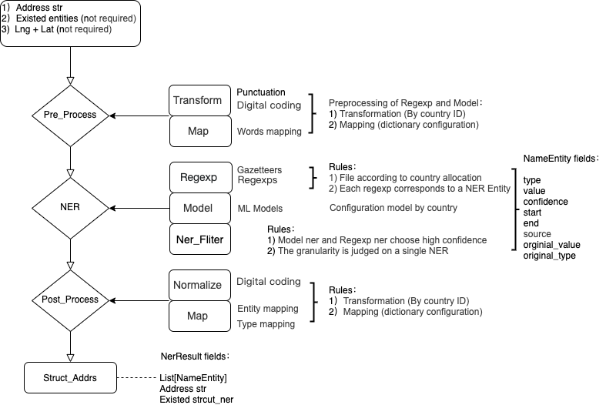
Tech design

Slide 25
Chanllenges
multi-lingual, especially non-English based language. อักษรไทย(Thai alphabet)
wrong spelling
wrong detail address
no standard Administrative division

Slide 26
Pros and Cons
Pros | Cons
stable and more accurate | extra work needed to build a standard structured address database
high generalize ablility (eg. apply in other logistic companies) | can mistakenly extract
can be corrected easily | as POI data(driver pin) accumulates, the advantage decreases

Slide 27
4. Theory discussion

Slide 28
Frame of discussion
questions | POI method | AOI method
How to define a zone?
How to define the relationship between a zone and an address?
How to define the accuracy? How to improve the method?
How does the method deal with a new address? How is its generalization ability?

Slide 29
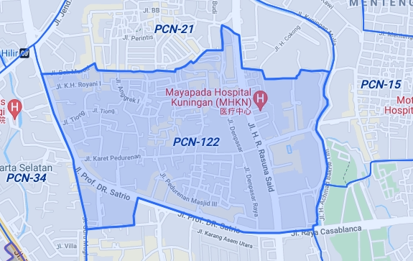
Q1: How to define a zone?
POI
AOI
AOI
Type:“point”,
Zone_desc:
[[[101.7379712, 3.1286358], [101.7384946, 3.1259788],
[101.739087, 3.122733]]]
Type:“aoi_id”,
Zone_desc:[1003120,1003130,1003140]
Pros: less accuracy of map needed or even no map needed

Slide 30
Q2: How to define the relationship between a zone and an address?
POI
AOI
ZONE1
ZONE2
ZONE
AOI-1
AOI-2
a
b
a
b
POI library address LL
match zone's LL boundary
POI-structured address -AOI-ZONE
Pros: unique and stable,
all right or all wrong,
easily to correct

Slide 31
Q3: How to define the accuracy? How to improve the method?
POI
AOI
2
zone
zone-1
a
zone-2
1
AOI-1
3
AOI-2
b
4
c
address actually location
centroid point
driver_pins
driver_pin 1,2,4 mismatch ,3 match
the centroid point of a,b,c belongs zone—1,but actually not
Pros: unique and stable, Will not be misled by the driver’s behavior

Slide 32
Q4: How does the method deal with a new address? How is its generalization ability?
POI
input a new address:Jl. Djatie rt014 rw003 no 43
text match: Jl. Cibubur VI Gang Kabel No. 43 Rt004/Rw004 Kelurahan Cibubur
match latitude & longitude to get zoneid
AOI
input a new address:Jl. Djatie rt014 rw003 no 43
state | city | district_id | sub_district | town | street | RW | RT
DKI JAKARTA | KOTA JAKARTA TIMUR | 78 | Rambutan | Rambutan | Djatie | Rw003 | Rt014
AOI
ZONE

Slide 33
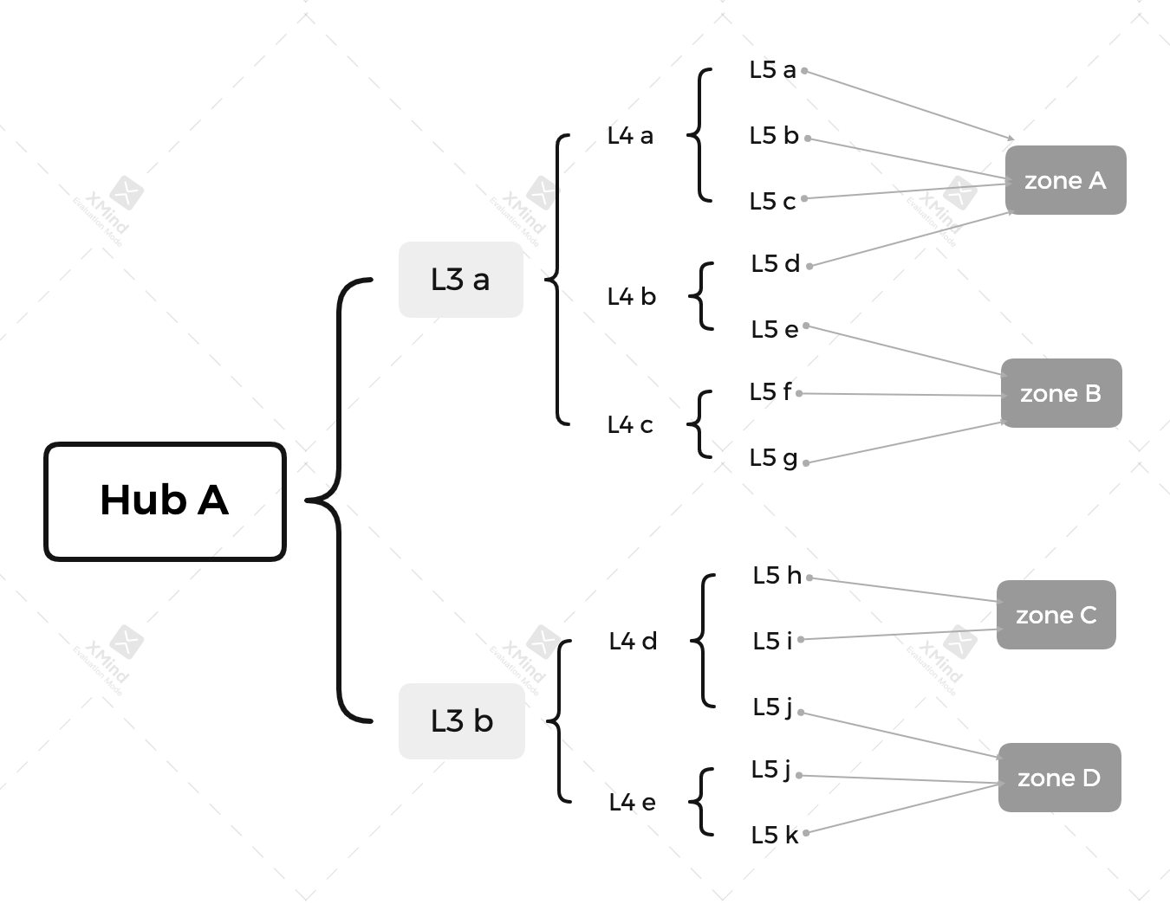
AOI can lead to another totally different path: hard-coded zone
Notes:
1、In Shunfeng express, drivers manually change the mapping relationship by month
2、In this way, we don’t need an accurate map service, and we don’t need longitude and latitude data

Slide 34
5. Looking forward into the future

Slide 35
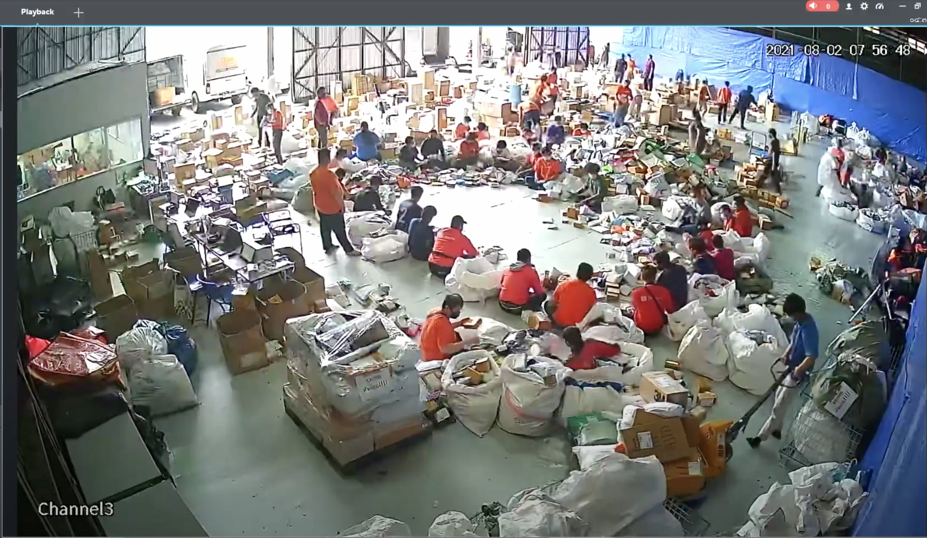
Sorting at single driver level

Slide 36
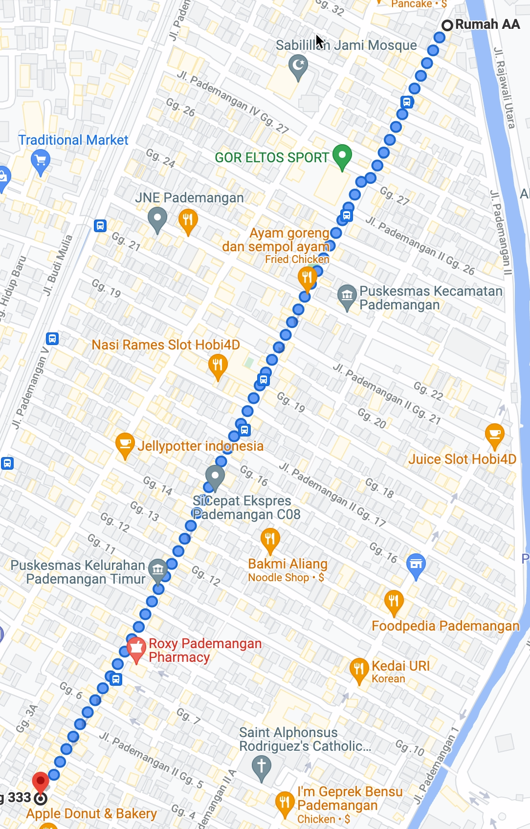
Sorting at single driver level
driver_id | 派单数
6205 | 4
6532 | 1
47048 | 5
60440 | 3
60866 | 19
64315 | 10
73078 | 4
86421 | 1
93734 | 21
Jalan pademangan 3

Slide 37
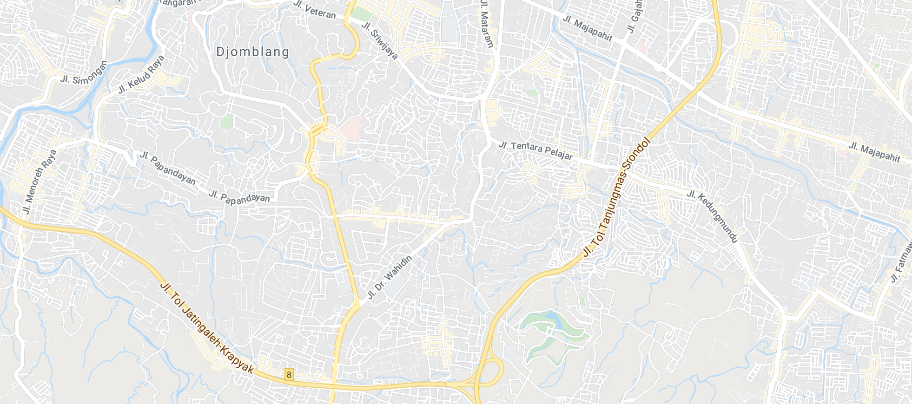

Dynamic zone
Static: sort destination addresses into
pre-defined delivery zones
Dynamic: each driver’s zone is computed by algorithm daily, depending on order density and other factors

Slide 38
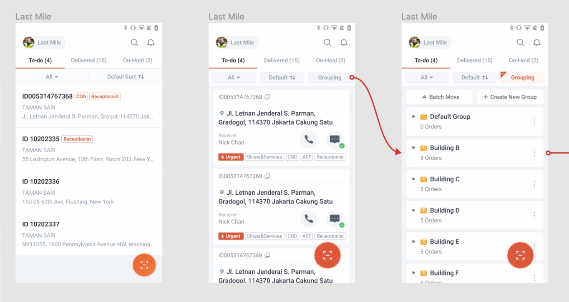
Grouping and Ordering
Old
New
(grouping)
Ordering

Slide 39
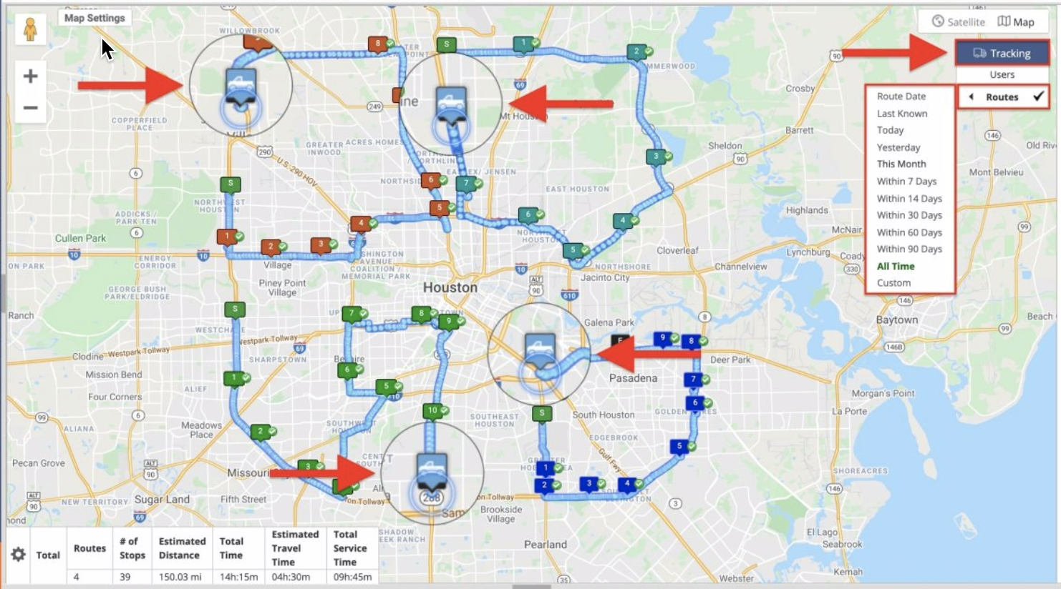
Routing

Slide 40
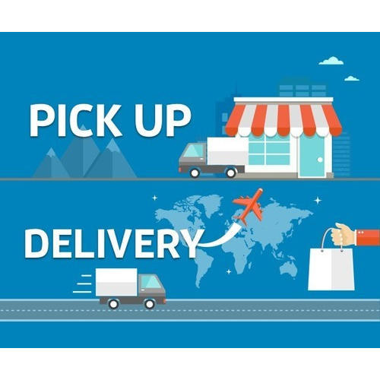
Apply in the Pick up Stage

Slide 41
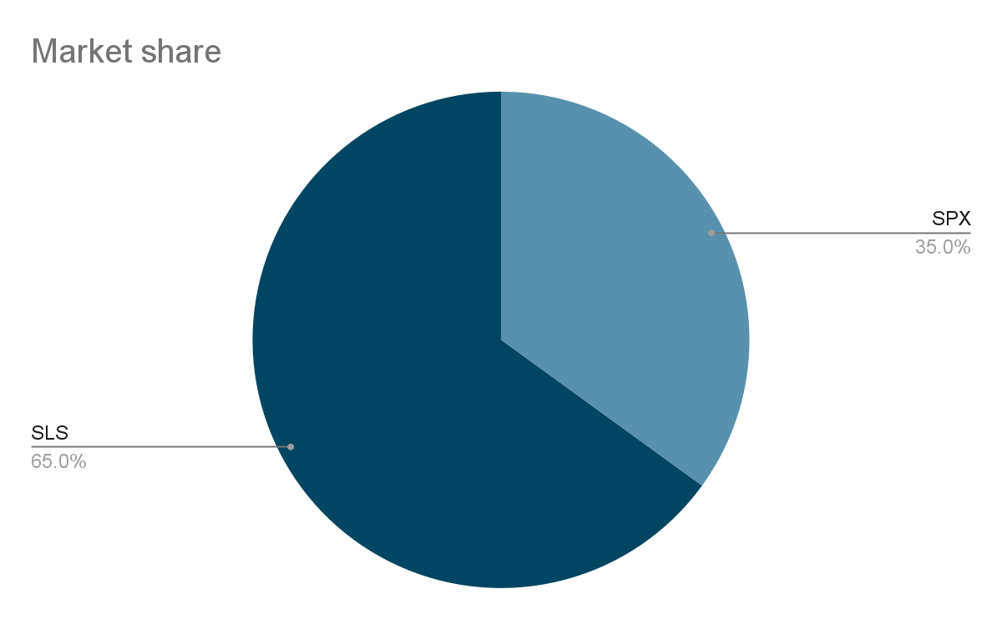
Apply in the Shopee Logistics Service
Alfatrex | International Express
Anteraja | J&T
Best Express | JNE
City-Link Express | Kerry Express
DHL | Ninja Xpress
Flash Express | Poslaju
GoGo Xpress | Thailand Post
Grab Express | The Lorry

Slide 42
Thank you for joining us

